Slide 1
Caribbean Sustainable Insurance Roadmap (CSIR)
Caribbean Insurance Conference (CIC) 2023, Montego Bay, Jamaica, 5 June 2023
IAC in proposed collaboration with UN PSI, IDB-Invest, Syntegra-360
Project lead: Dr Axel Kravatzky

Slide 2
COP21 in Paris
At CIC 2022 we heard from Dr James Fletcher how the Caribbean Delegation lead and insisted on 1.5C

Slide 3
UK & Caribbean are leading global effort – Integrated Governance for Sustainable Development
ISO/TC309 Governance of organizations

Slide 4
Caribbean Sustainable Insurance Roadmap (CSIR)
Board of IAC has decided to commit and lead this initiative

Slide 5
4 Principles
1. Firm level embed ESG decision-making
3. Work with governments, regulators, and other stakeholders to promote ESG action
2. Clients & business partners ESG awareness, manage risk, solutions
4. Accountability & transparency by disclosing progress
Principles for Sustainable Insurance, 2012
Notes:
Carrier of financial risk – underwriting
Manager of physical risk – understand, prevent, reduce, transfer
Investor role – asset manager

Slide 6
3 Roles of Insurance Industry
Manager of physical risk – understand, prevent, reduce, transfer
Carrier of financial risk – underwriting
Investor role – asset manager
Principles for Sustainable Insurance, 2012
Notes:
Carrier of financial risk – underwriting
Manager of physical risk – understand, prevent, reduce, transfer
Investor role – asset manager

Slide 7
Background continued
UN and Insurance Industry have partnered for ambitious action

Slide 8
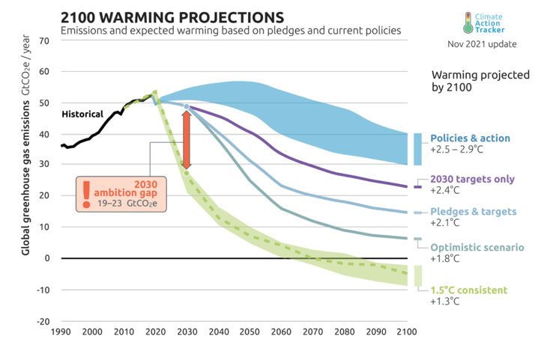
Pillar 1: Risks and Opportunities
Disruption
Trusted decision useful information
Temperatures | Climate Action Tracker

Slide 9
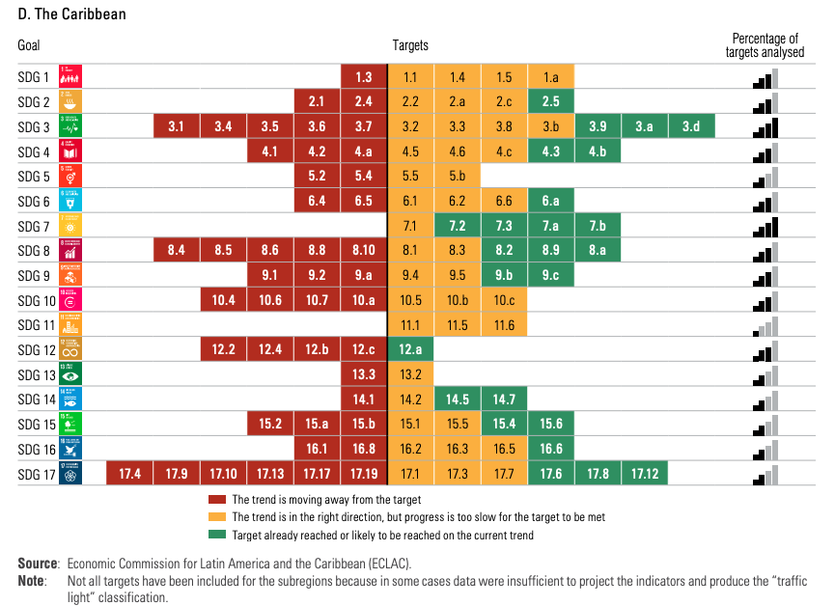
Pillar 2: Insuring the transition
23% of SDG targets are on track in the Caribbean
Underinsured Caribbean
Escalating costs and de-risking problem
Innovative, multiple stakeholder solutions
Halfway to 2030 in Latin America and the Caribbean: progress and recommendations for acceleration (cepal.org), p. 86
Notes:
(20) Therese Turner-Jones on Twitter: "⁦@eclac_un⁩ Caribbean region well off the mark for reaching SDGs by 2030..a mere 23 percent of the targets are on track. We need to do a massive sprint https://t.co/2FWLRRE7yJ" / Twitter

Slide 10
Pillar 3: Responsible Investment
PSI Principle 1: We will embed in our decision-making environmental, social and governance issues relevant to our insurance business
Investment Management
Integrate ESG issues into investment decision-making and ownership practices (e.g. by implementing the Principles for Responsible Investment)

Slide 11
Governance of the project
Caribbean Sustainable Insurance Roadmap (CSIR)
Steering Committee
Sets overall scope/focus, timing.
Goals and metrics
Provides needed resources and authority
Eliminates barriers to success
Ensures integration with other parts of organization
Attends significant sessions
Role Allocation
Sponsor – TBC
Steering Committee – TBC
CSIR Leader – TBC
CSIR Leadership Team – TBC
CSIR Working Groups - TBC
Sponsor
Individual with highest line authority over SIR process;
Primary influencer of values and culture;
Sets parameters, allocates resources, and has veto power over decisions;
Keeps SIR process aligned to overall organizational strategy
CSIR Leader
CSIR Leadership Team
Group of leaders or key stakeholders across key functional areas with delegated authority to shape both the desired outcomes and the change process;
Responsible for supporting and modeling the desired outcomes of the change process in terms of mindset and behaviors; Actively involved in directing and guiding communication and course correcting
Person delegated the authority by the sponsor to lead the CSIR process;
Facilitates the process of defining, planning and course correcting the change strategy and process in collaboration with change consultants;
Clarifies scope, outcomes, pace, conditions for success, constraints and infrastructure;
Oversees communication, information generation
Syntegra & Partner Resources
CSIR Consultants
Knowledge and execution partner
Educate on change & strategies for how to proceed;
Helps plan change strategy and major events, communications, training sessions and meetings;
Assesses progress, problems, concerns, political and cultural issues;
Coaches, provides feedback, and acts as a sounding board for sponsor and CSIR leader.
CSIR Working Groups
Cross functional representatives, sub-project / process leaders and/or specially-skilled individuals who assist the SIR leader in the day-to-day activities of facilitating the SIR strategy.

Slide 12
Key project contacts (thus far…)
Contact Musa, Janelle, or Axel if you want to engage
Musa Ibrahim, President IAC
musa.ibrahim@tatil.co.tt
Janelle Thompson, CEO IAC
janelle@iac-caribbean.com
Butch Bacani, UN PSI
butch.bacani@un.org
Stephen Thomas, Principal Officer - Financial Institutions at IDB Invest
stephent@iadb.org
Axel Kravatzky, Managing Partner, Syntegra-360
Axel.kravatzky@syntegra-360.com

Slide 13
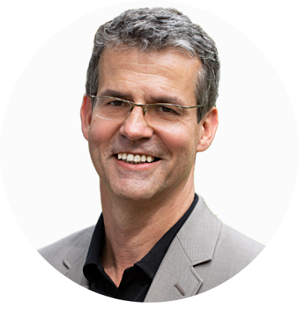
Contact
Dr Axel Kravatzky Managing Partner axel.kravatzky@Syntegra-360.com +1-868-684-9710 WhatsApp
Book a meeting: https://usemotion.com/meet/axel-kravatzky/meeting

Slide 14
Thank you
Dr Axel Kravatzky
www.Syntegra-360.com

